Slide 1
Welcome to Parent Orientation!
Ms. Severinson’s Class
Notes:
*
Introduce ourselves

Slide 2
Language Arts
The Leander ISD Elementary Language Arts Program is based on a balanced literacy approach. This approach to instruction provides students with daily opportunities to engage in various reading and writing activities to help them communicate more effectively.
DRA level is taken at least 2 times a year and will help individualize small group instruction.
50 Instructional at BOY, 50 Independent at EOY
Notes:
*
Sharon

Slide 3
Language Arts Units of Study
Units of Study | * Setting Up Your Systems for a Comprehensive Literacy Classroom * Past to Present: Connecting with Historical and Realistic Fiction * Tell Me About It: Analyzing Informational and Expository Texts | * Believe It or Not: Identifying Persuasion in Reading, Writing, and the Media * Imagine That: Investigating Fiction * Life Links: Comparing Different Genres and Common Themes | * Recognizing People and Perspectives Through Biographies, Autobiographies and Letters * Developing and Performing Procedural Texts | * Analyzing the Sound in Poetry * Synthesizing Research Topics

Slide 4
Reading
Shared Reading, Guided Reading, Independent Reading, Read Alouds/Modeled Reading
Reading Comprehension Strategies (making connections, questioning, visualizing, inferring, determining importance/main idea, synthesizing)
Notice & Note Signposts to promote deep thinking
Notes:
*
Sharon
Guided Reading will happen in class, check in with your child at home to be sure they are reading “just right” books. *parent conferences, check with teacher if you’re unsure of level. Please read even with your higher reading level kiddos to help them continue to improve their ORF and comp.

Slide 5
Writing
Modeled, shared, interactive, guided & independent writing
Parts of speech, grammar, punctuation, and usage
6 Traits - Ideas, Organization, Voice, Sentence Fluency, Conventions, Publishing
Writing pieces will include: personal narrative, persuasive pieces, imaginative story, letters, and a biography research report.
/
Notes:
*
Writer’s notebook (binder) to keep writing assignments in; writing journal for free writing time; show grammar packet.

Slide 6
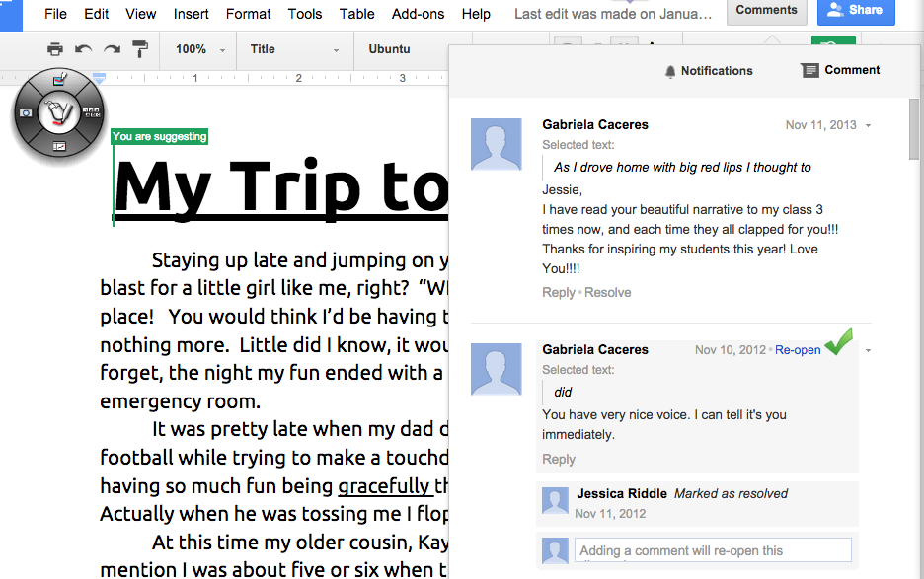

Slide 7
Mountain Language
Common/Proper Nouns
Singular/Plural Words
Contractions
Abbreviations
Similes, Metaphors, Idioms, Adages, and Proverbs
Prefix, Root Word, Suffix
Possessives
Synonyms
Subject/Predicate
Dictionary Guide Word
Analogies
Syllables
Proofreading
Fact/Opinion
Correlative Conjunctions
Spelling
Same Sound
Categories
ABC Order.
Antonyms
Brainstorming

Slide 8
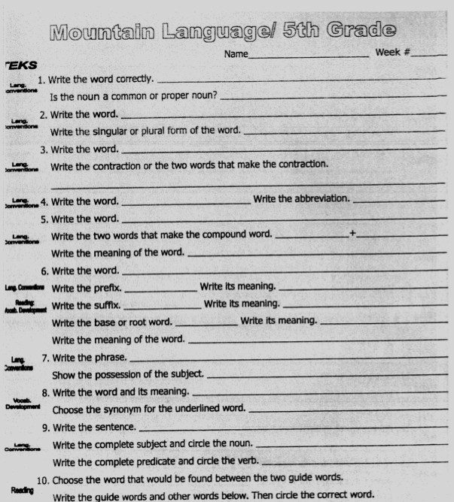
￼
￼

Slide 9
Spelling
Rebecca Sitton: • Based on high frequency words that students will need in their everyday writing (5 Core Words in each unit). • Builds general understandings that students will be able to transfer to new and different words they may need to spell
**The goal of this program is to provide students with lifelong spelling abilities. Therefore it emphasizes the learning of important words, not for a Friday test, but for a lifetime of spelling in the real world—that is, spelling correctly in writing.**
Notes:
*
Emily

Slide 10
More Spelling!
Students will have spelling instruction and will participate in mini lessons.
On Fridays, the assessment will be in the form of a cloze passage test.
Spelling homework will be assigned on Monday and will be due on Friday.
Notes:
*
Emily

Slide 11
Social Studies
The integration of Social Studies with Language Arts will help students synthesize many academic skills.
Leander ISD has a new adoption for Social Studies called USA Studies Weekly. It is a weekly newspaper that covers 100% of the fifth grade TEKS.
In addition to the USA Studies Weekly, History Alive, Discovery Education internet streaming videos, newspapers, maps, historical fiction novels, as well as the internet will serve as instructional resources.
Notes:
Show the newspaper.

Slide 12
Social Studies (continued)
Students will gain an understanding of how people, important events, and ideas shape the history of the United States.
Units:
Map Skills, Geography terms
Europeans Settle in North America
Revolution
Forming a Nation
Westward Expansion
Civil War and Reconstruction
20th and 21st Centuries

Slide 13
Homework
Reading -- nightly for pleasure; 100-120 minutes/week is ideal (record titles/times in planner)
Reading --Reading Benchmark passages
Spelling--skill sheet, study words
Social studies - from time to time
Unfinished class work, if necessary
Notes:
*
Emily- 30 minutes per day rule (grade X’s 10), always a review of skills taught the week before

Slide 14
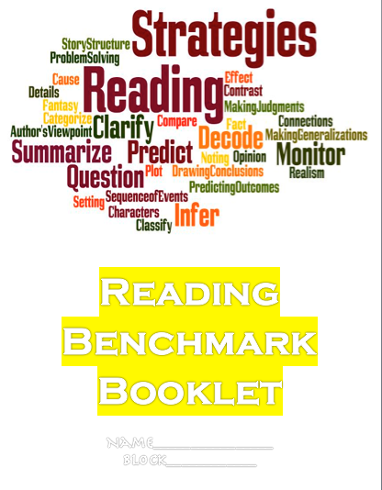
Reading Benchmark
Includes a wide variety
of genres:
-non fiction (historical/science)
-fiction (realistic, historical, science, etc.)
-drama (historical/realistic)
-poetry
-speeches
-persuasive
-informational (articles/web blogs)
-

Slide 16
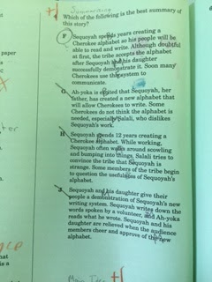
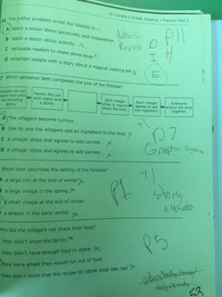

Slide 17
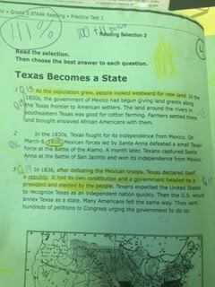
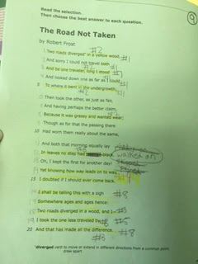

Slide 18
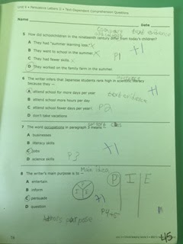

Slide 19
Communication
Planner- comes home daily and may contain homework and spelling words. The purpose of the weekly planner is to help your child get organized, particularly with homework. Please assist your child in using this planner.
Wednesday Folder- Contains letters from school and graded papers. Please empty and return on Thursday.
Newsletters- will be emailed weekly to keep you updated on what is happening in the classroom.
Bloomz App - to send additional information/notifications
Our parent conference time is from 1:45 to 2:30.
Notes:
*
Cailtin

Slide 20
Thanks for Being Here!
Jennifer Severinson
jennifer.severinson@leanderisd.org
Notes:
*

